Slide 1
WATER DISTRIBUTION AND MANAGEMENT
LRG GOVERNMENT ARTS COLLEGE FOR WOMEN
JAMUNA.A,III –BSC COMPUTER SCIENCE (SHIFT I)
GUIDE MAM: Mrs SUGANTHI.N

Slide 2
ABSTRACT
A water distribution and management system is main focus for managing the water factory. Which system has to be followed and managing the result of billing purchase and stock details. In this society there is a lot of customers can be using this application. In this application as work flow was every user has an unique username and password, the user enter the login and then only open this application. The user collect the customer details via this application and view their customer details. We have to covered purchase, sales and billing modules as well as possible. This application may be reduce many man power issue and resolving the wanted issues so which is very user friendly for every users. We can track the orders details and stock counts as possible to manage

Slide 3
OBJECTIVE
The two primary objectives in design and operation of water distribution system are
Minimisation of the cost of supplying water .
Maximisation of reliability in the supply of water.

Slide 4
HARDWARE SPECFICATION
Processor : P 4 700 GHz.
RAM : 4 GB RAM
Hard Disk Drive : 180 GB

Slide 5
SOFTWARE SPECIFICATION
Operating System : Windows 7/8/10
Front End : JAVA
Back End : MYSQL

Slide 6
EXISTING SYSTEM
Its paper based application to managing water supply is difficult to handle it. The customer details are manually noted in the note or diary and hard to search their customer details. Also difficult to calculate stock and billing details as well
DISADVANTAGES
The existing system has the following drawbacks.
Managing the customer details is impossible
Can’t maintain the billing details
Can’t maintain the water quality details

Slide 7
PROPOSED SYSTEM
This proposed system overcome above mentioned the existing system. Which can be register their customer details and water supply details etc… The design of an application can be very user friendly to communicate all the users.
ADVANTAGES
User friendly application
Maintain daily the billing details

Slide 8
Modules
Customer Registration
A customer registration module is used collect the information details. Which is used to when the customer purchasing the water their details should be collect from this software. It’s may be used for further contact
Purchase Entry
When the shop owner purchasing the water it should register this purchase module. It’s managed by shop owner then collect the information about the water quantity and price etc… After the purchasing only should sales the product.

Slide 9
3.Sales Entry
This module calling when the customer have to be purchased and before billing. It will show the all the details about the water and customer details. Which is basically used to find the stock entry details. A sales module collect the customer information so we can contact the customer easily.
4. Stock Entry
This Stock module will be helps to find the stock of the quantity waters are available in shop. Which could be used for user can easy to analyst for purchasing.
5. Billing Module
This module shows an billing detail, how many liters can be sales in date wise and how much are they gain. Total entire application will be showing in this module.

Slide 10

Data Flow Diagram
Level 0

Slide 11
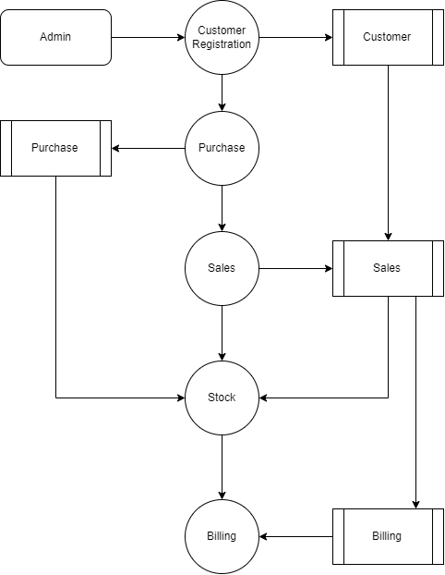
Level 1:

Slide 12
TABLE DESIGN TABLE NAME:ADMIN
FIELD | DATA TYPE | SIZE | CONSTRAINT
Admin id | Int | 10 | Primary key
Username | Varchar | 30 | Not null
password | Varchar | 30 | Not null

Slide 13
TABLE NAME:CUSTOMER
FIELD | DATA TYPE | SIZE | CONSTRAINT
Id | Int | 10 | Primary key
Name | Varchar | 20 | Not null
Mobile | Int | 10 | Not null
Email | Varchar | 30 | Not null
Address | Varchar | 30 | Not null
Gender | Varchar | 10 | Not null

Slide 14
TABLE NAME:Product
FIELD | DATA TYPE | SIZE | CONSTRAINT
Product id | Int | 10 | Primary key
Company | Varchar | 30 | Not null
Model | Varchar | 30 | Not null
Price | Int | 5 | Not null

Slide 15
TABLE NAME:PURCHASE
FIELD | DATA TYPE | SIZE | CONSTRAINT
Purchase id | Int | 10 | Primary key
Product id | Int | 10 | Foreign key
Quantity | Int | 5 | Not null
Price | Int | 10 | Not null
Date | Date | 10 | Not null

Slide 16
TABLE NAME:SALES
FIELD | DATA TYPE | SIZE | CONSTRAINT
Sales id | Int | 10 | Primary key
Customer id | Int | 10 | Foreign key
Product id | Int | 10 | Foreign key
quantity | Int | 5 | Not null

Slide 17
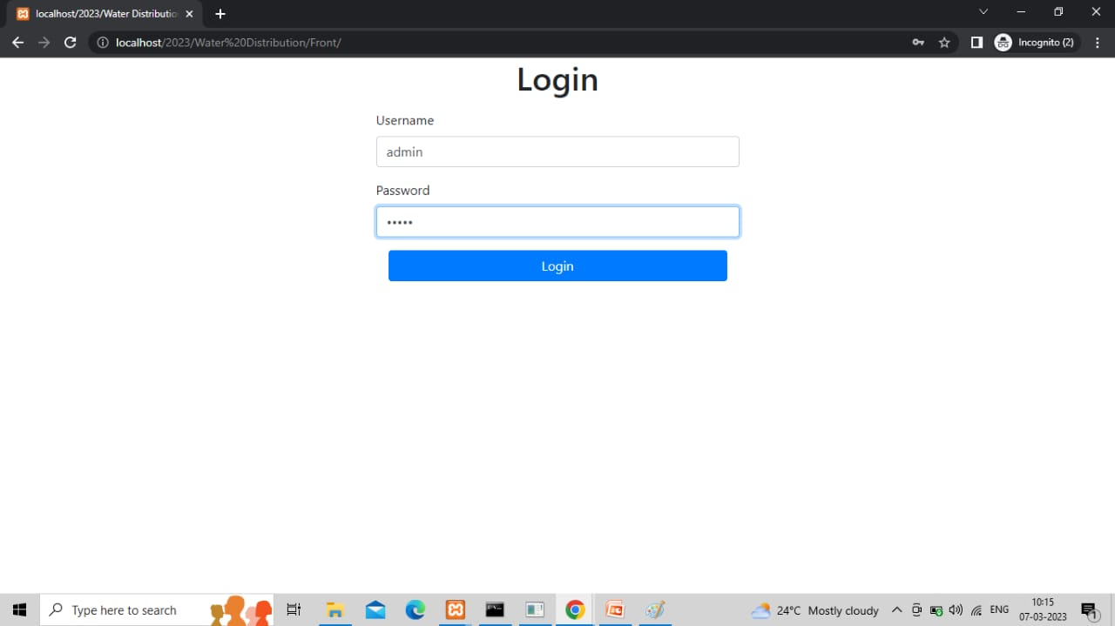
ADMIN LOGIN

Slide 18
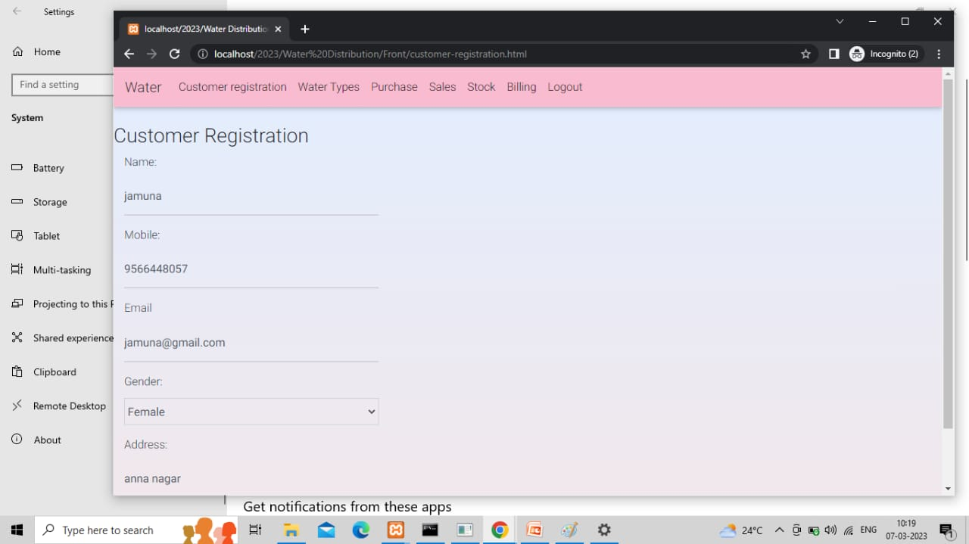
CUSTOMER REGISTRATION

Slide 19
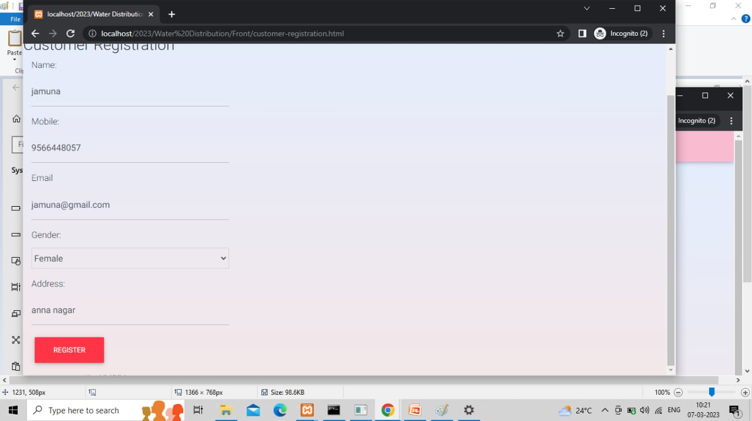

Slide 20
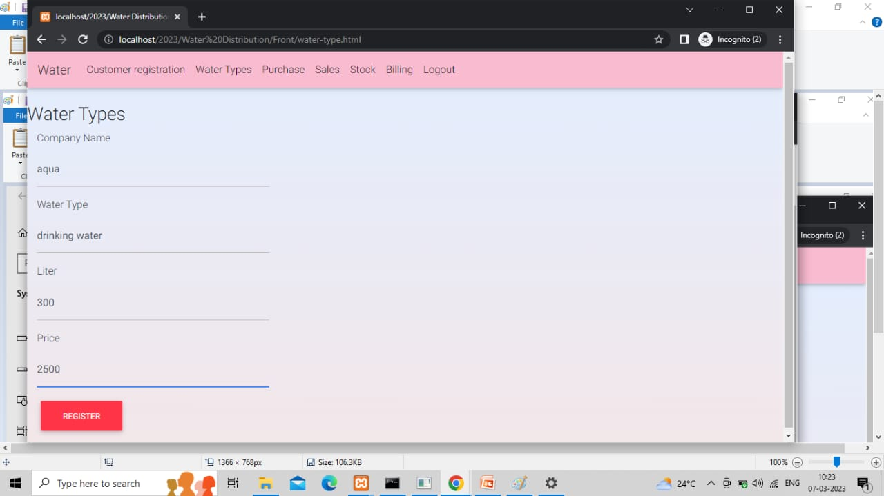
WATER TYPES

Slide 21
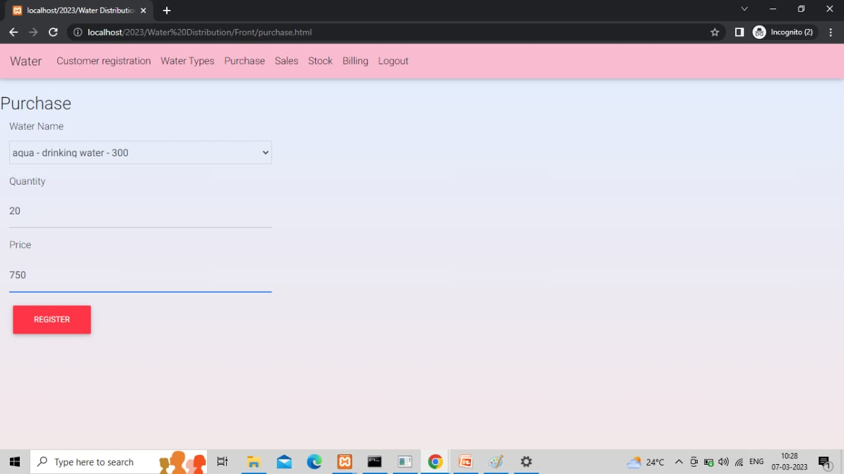
PURCHASE DETAILS

Slide 22
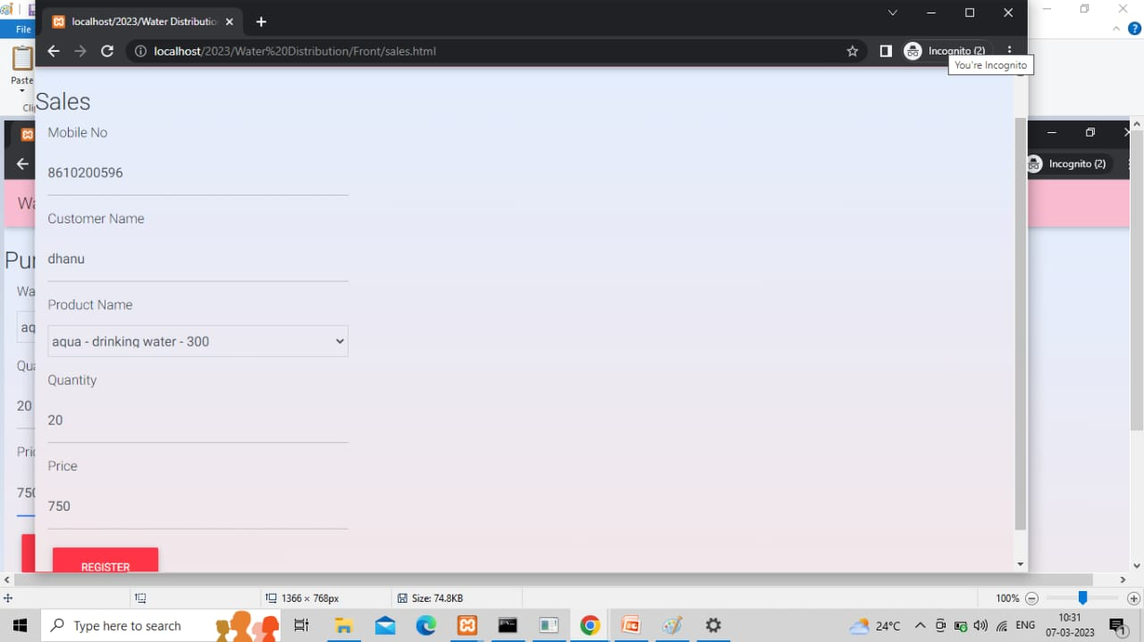
SALES DETAILS

Slide 23
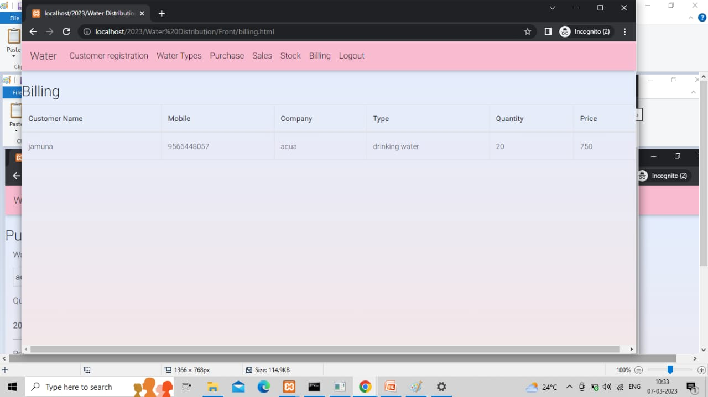
BILLING DETAILS

Slide 24
Thank You

